Slide 1
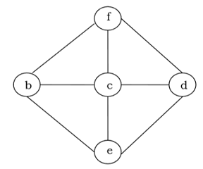
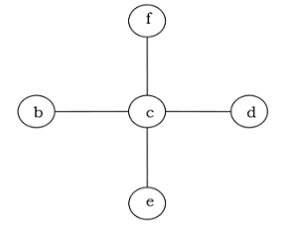
Minimum Spanning Tree
A spanning tree of a connected undirected graph G is a tree that minimally includes all of the vertices of G. A graph may have many spanning trees.

Slide 2
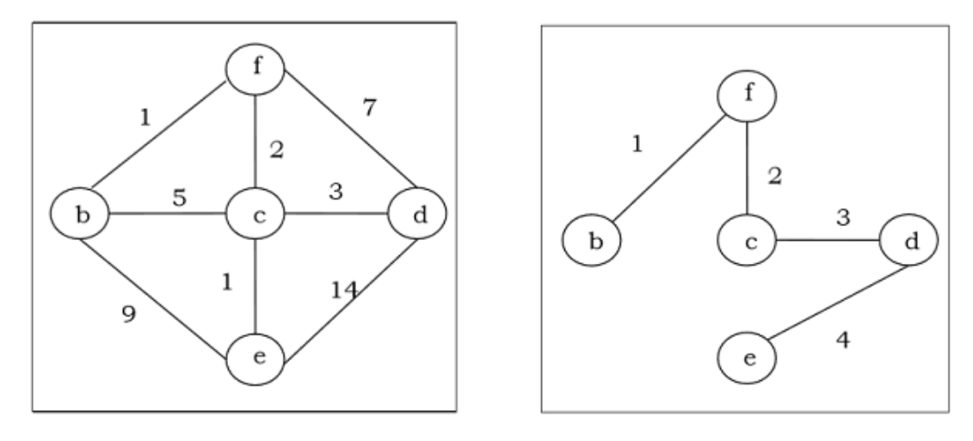
More Examples

Slide 3
Kruskal's Algorithm
Kruskal's algorithm is a greedy algorithm that finds a minimum spanning tree for a connected weighted graph. It finds a tree of that graph which includes every vertex and the total weight of all the edges in the tree is less than or equal to every possible spanning tree.

Slide 4
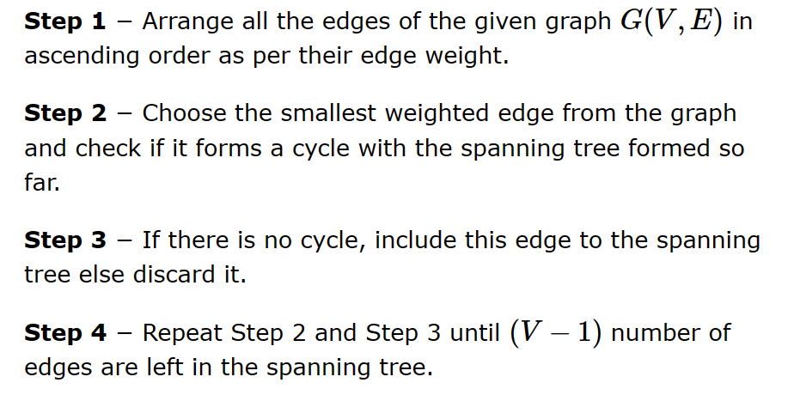
Steps

Slide 5
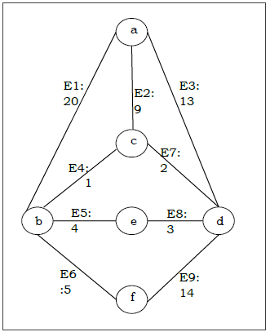
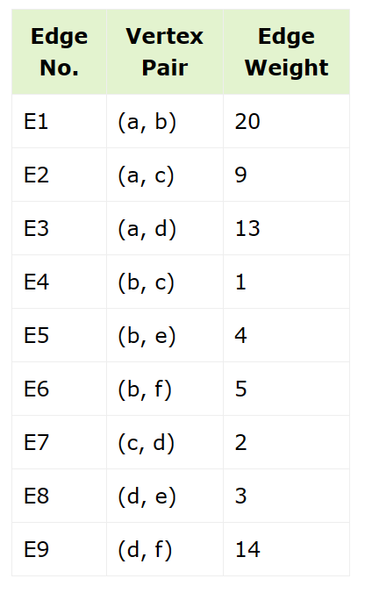
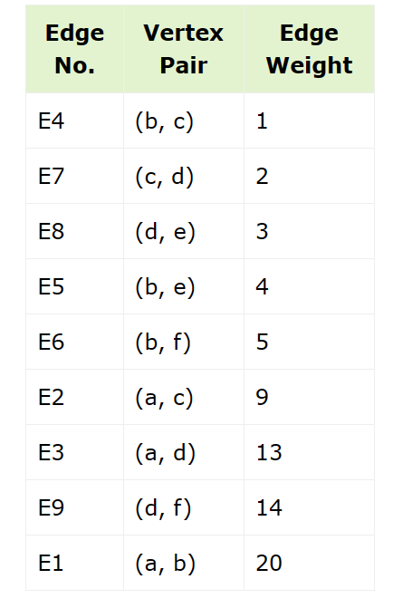
Suppose we want to find minimum spanning tree for the following graph G using Kruskal’s algorithm.

Slide 6
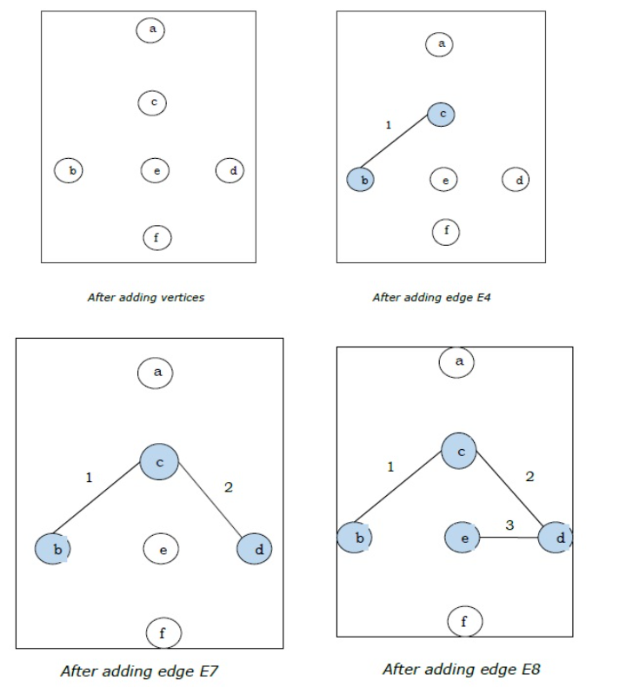
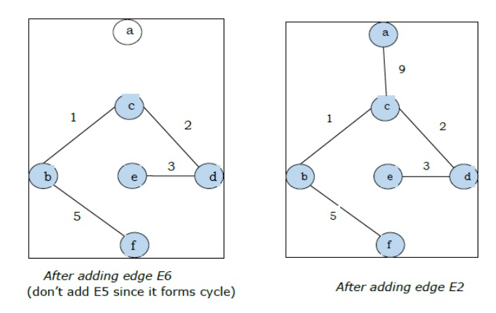
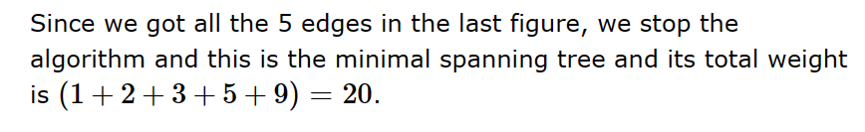
Steps

Slide 7
Prim’s Algorithm
Prim's algorithm, discovered in 1930 by mathematicians, Vojtech Jarnik and Robert C. Prim, is a greedy algorithm that finds a minimum spanning tree for a connected weighted graph. It finds a tree of that graph which includes every vertex and the total weight of all the edges in the tree is less than or equal to every possible spanning tree. Prim’s algorithm is faster on dense graphs.

Slide 8
Steps
Initialize the minimal spanning tree with a single vertex, randomly chosen from the graph.
Repeat steps 3 and 4 until all the vertices are included in the tree.
Select an edge that connects the tree with a vertex not yet in the tree, so that the weight of the edge is minimal and inclusion of the edge does not form a cycle.
Add the selected edge and the vertex that it connects to the tree.

Slide 9
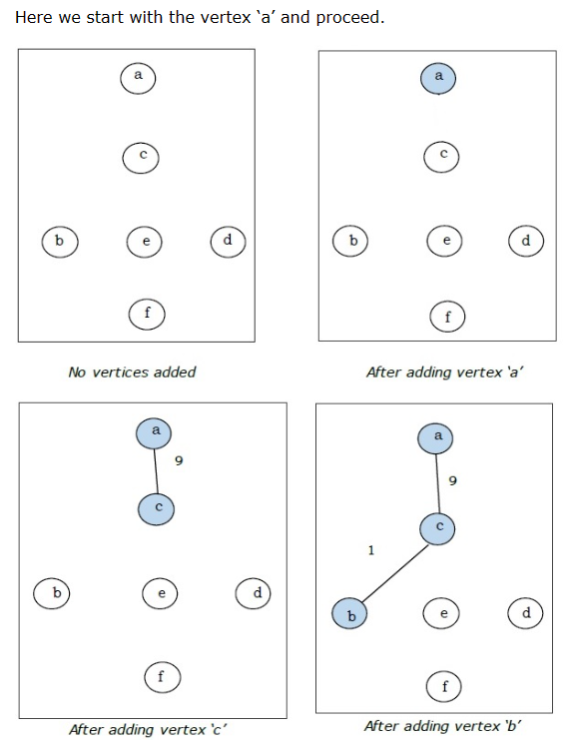
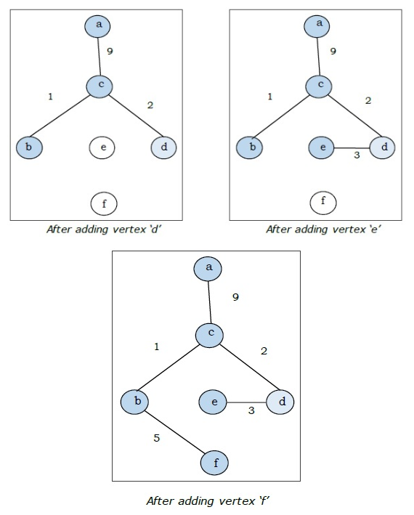
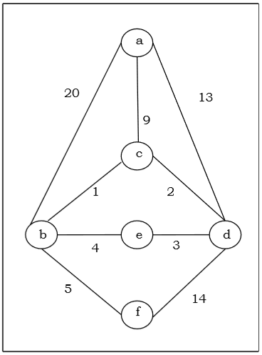

Suppose we want to find minimum spanning tree for the following graph G using Prim’s algorithm.

